Slide 1
Internship Return Day
Muskan Bhat
Company: Y The Wait

Slide 2


Company
Y The Wait
Headquarters in Rivium Capelle a/d ijssel
Rapidly growing multinational company

Slide 3
About Y The Wait
an extensive platform developed to provide hospitality features to various types of customers
The customers of the company include the an app user that uses app to access hospitality services of the business owners registered with Y The Wait, and the businesses registered with the company including restaurants, hotels, supermarkets, event halls, etc.
The basic module contains the digital waiter service, delivery/takeaway/reservation, and exclusively for business owners, are the services like point of service software, staff app, etc.
The are currently active in Canada, USA, Netherlands, Lebanon and India.
Their business model is Peer to peer which is two individuals interact to buy sell goods and services directly with each other or produce goods and service together

Slide 4
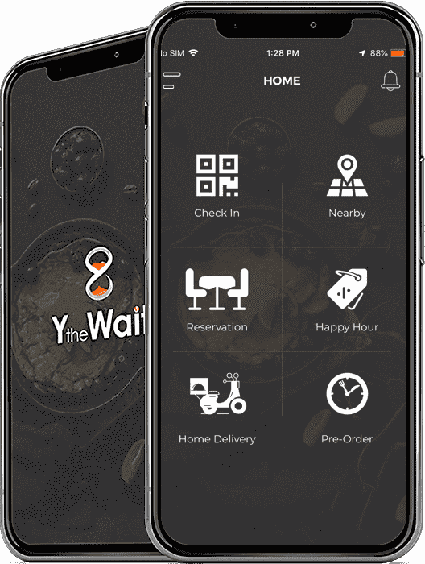
About the product and services of company
The services of Y the Wait are all about evolving hospitality service experience, it serves to eliminate all inconveniences people experience during a restaurant dine-in or a home delivery order.
Their competitors are not any specific firm because no one is right now providing these features or services exactly like them. Some similar firms are, Thuisberzorgd, UberEats or Deliveroo.
The products starting from the app is basically a food ordering app, we can make reservations, take dine in or take away orders. Rest are the tools we provide the merchants to use our services.
Those tools are point of sale, the staff app. The dashboard meanwhile is a web based admin panel used by business owners

Slide 5
Workplace environment
Friendly
Open to suggestion
Distance working with the team in India
Communication points
Weekly reports

Slide 6
My assignment
Making Ordering websites for the merchants/clients on the basis of designs provided by the design team.
My assignment is rebuilding the web based dashboard, which is primarily based on HTML, CSS and jQuery. The goal is to eliminate jQuery and rely entirely on JavaScript es6 and react with redux. The assignment though merely sounds like changing from one language to another but the dashboard consists of various modules and is an extensive module to build.
The modules in the web based dashboard include restaurant information, requests, menu, Orders, happy hours etc.

Slide 7
How is it going?
First 2 weeks learning react and redux basics, still a lot to learn
Next I was given to make ordering website for a restaurants(merchants), in progress.
The dashboard assignment is yet to begin.

Slide 8
reflection
How it started
How its going
Problems
Solutions

Slide 9
Questions?

